Slide 1


Software Engineering Project 2nd Presentation
Tom Leonard and Lucas Villiere

Slide 2

Defining the parameters of the project
We decided on a new direction for the project :
A Swift app with fun trivia quizzes regarding the FSTM.
Possible addition of future game modes (such as hangman, etc.)
We realised that we both had vastly different ideas of what the project would entail.

Slide 3



Why using Swift ?
We chose Swift as a programming language because both of us have significant experience with the language.
Also it has enough resources online that we believe, it will be an asset and not a detriment to our project.

Slide 4

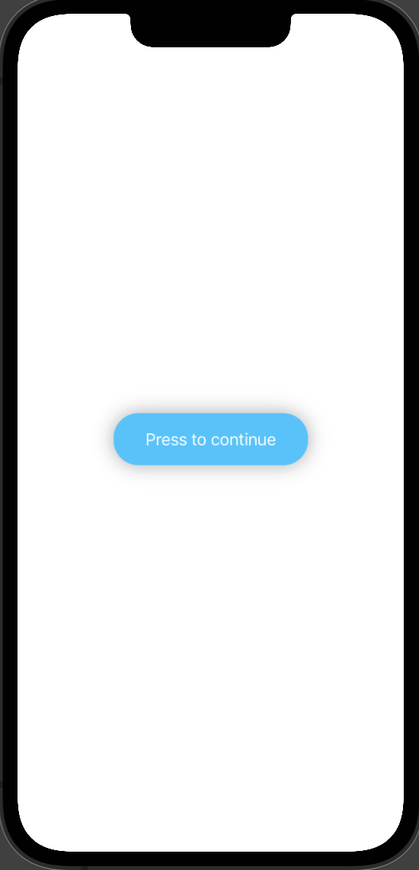
What do we have for now ?
A nice-looking button and progress bar

Slide 5
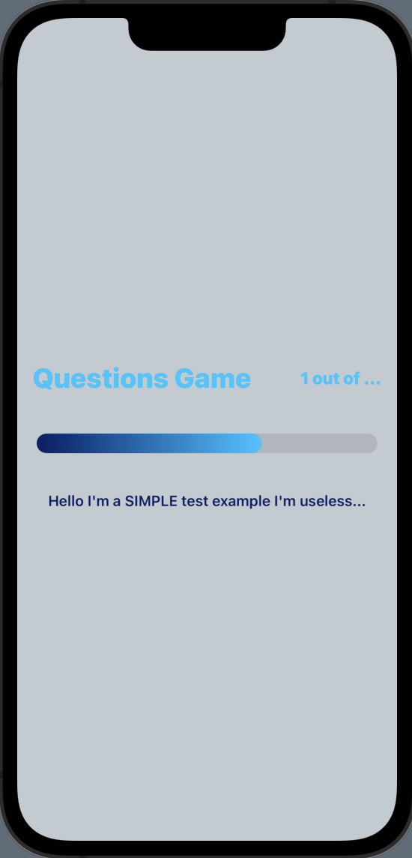
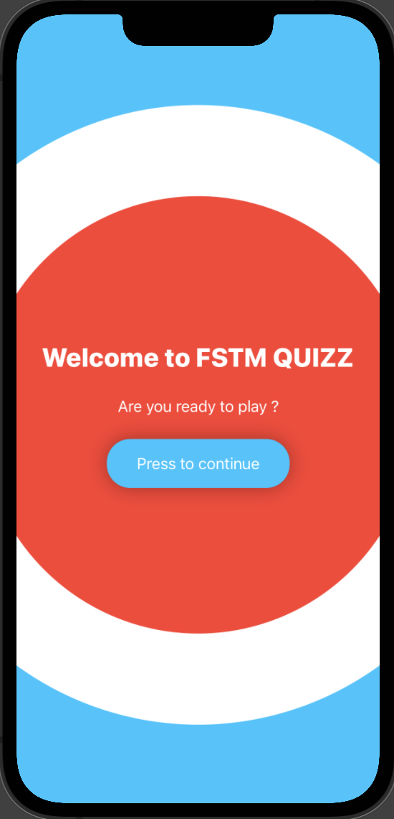
What do we have for now ?
A Home Page
And a Game Page demo

Slide 6

What do want for the future ?
Creating a menu with some nice buttons
Finishing the Game Page
Creating a database using Json (for the questions)
We’ll see later to add new stuff in the project

Slide 7
Any questions ?

